Slide 1

QB Success
Mark Belgeri

Slide 2
What is success for a quarterback and what does this correlate to?
Quarterbacks are typically judged on their consistency and ability to avoid mistakes. To this end the gold standard of each of those two areas is typically held to be completion percentage and interceptions, respectively. This should not be the case as yards per pass attempt and sacks are better predictors of success.

Slide 3
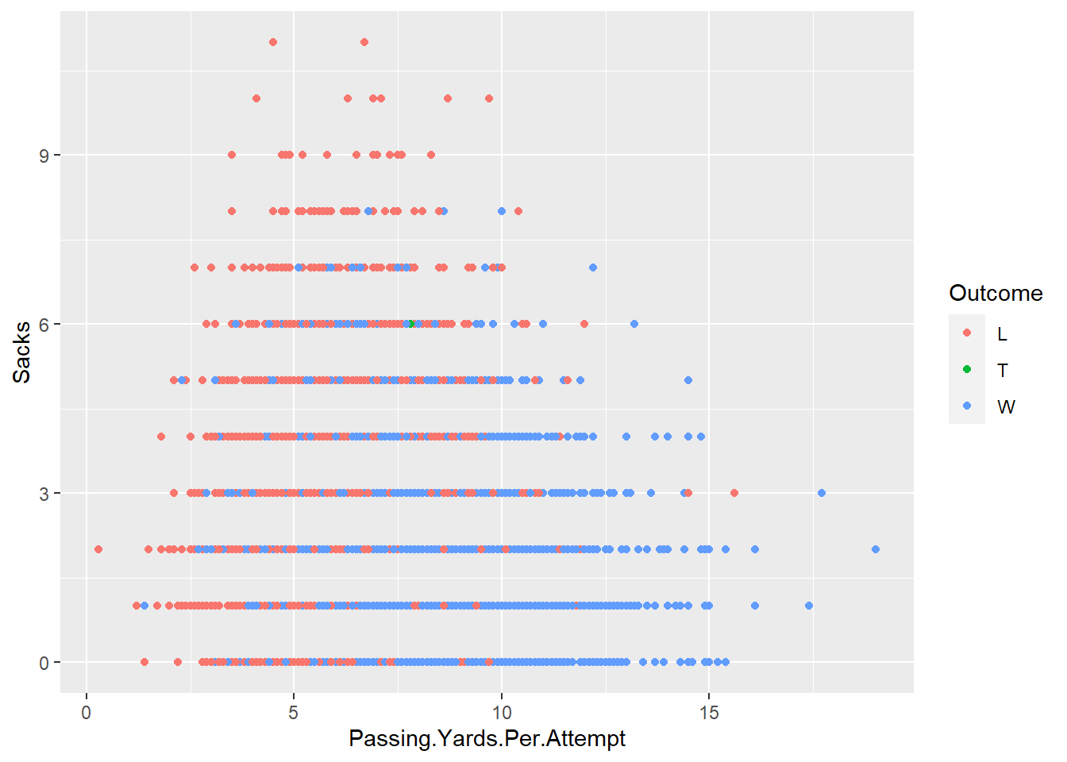
Is there a relationship?

Slide 4
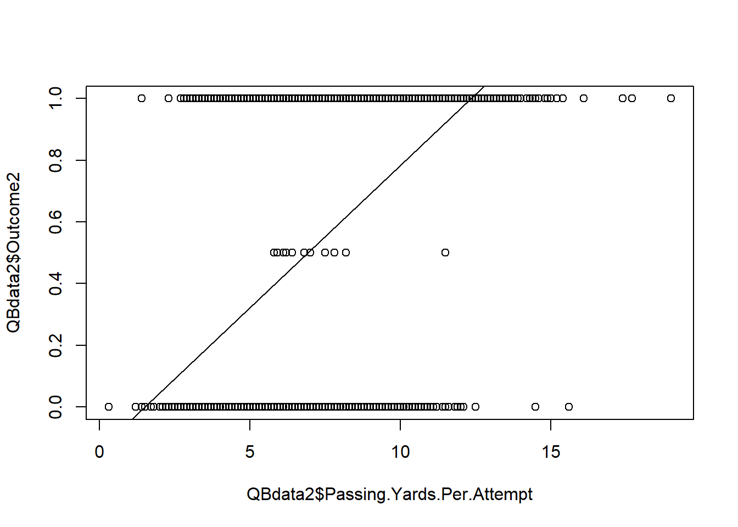
What is the relationship between yards per pass attempt and wins?
Correlation = 0.3583886
With a regression line of
Win Probability = .092301YPA - .137784

Slide 5
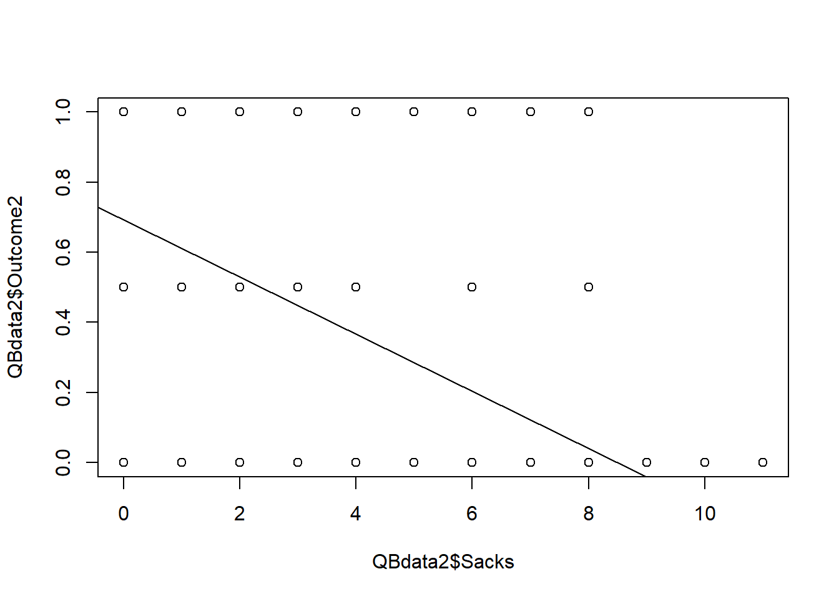
What is the relationship between sacks and wins?
Correlation = -0.2751112
Regression line: Win Probability = -.081591 * Sacks + .692536

Slide 6
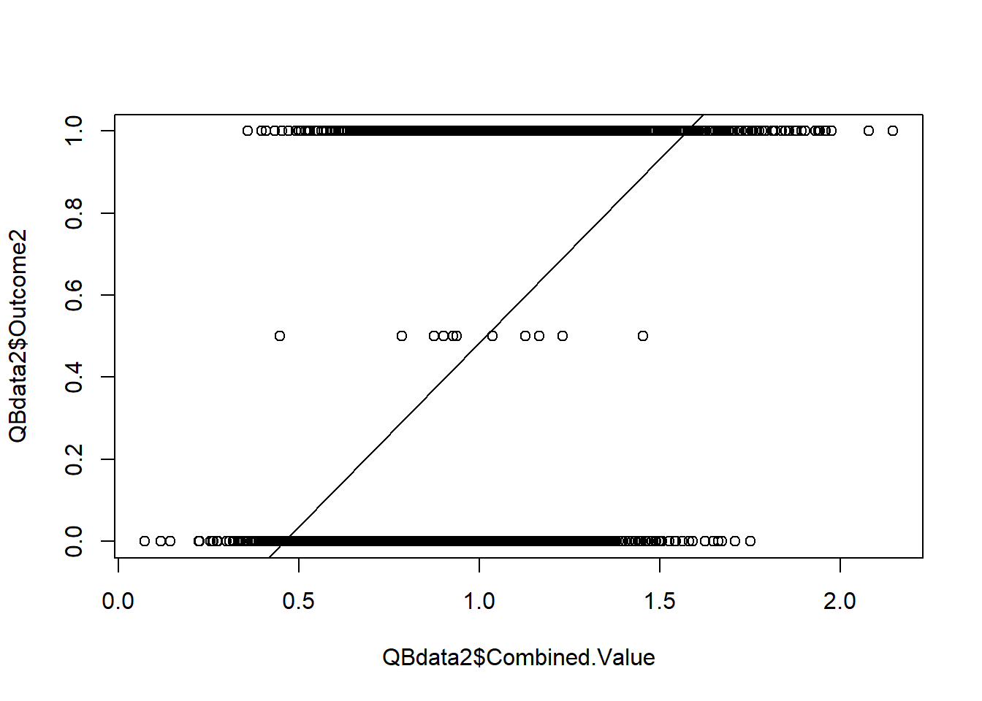
What is the relationship when the regressions for sacks and yards per pass attempt are combined and compared to wins? Correlation = 0.4281198 Combined Value = (.092301 * Passing Yards Per Attempt) - (.081591 * Sacks) + .554752 I did not weight the regressions. They were treated equally.

Slide 7
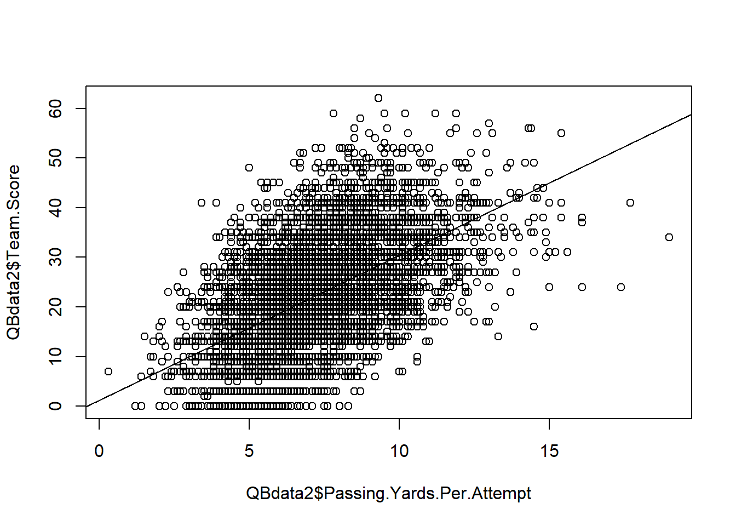
What is the relationship between yards per pass attempt(YPA) and points scored?
Correlation = 0.5535805
Regression line:
Team Score = 2.91657 * YPA + 1.20515

Slide 8
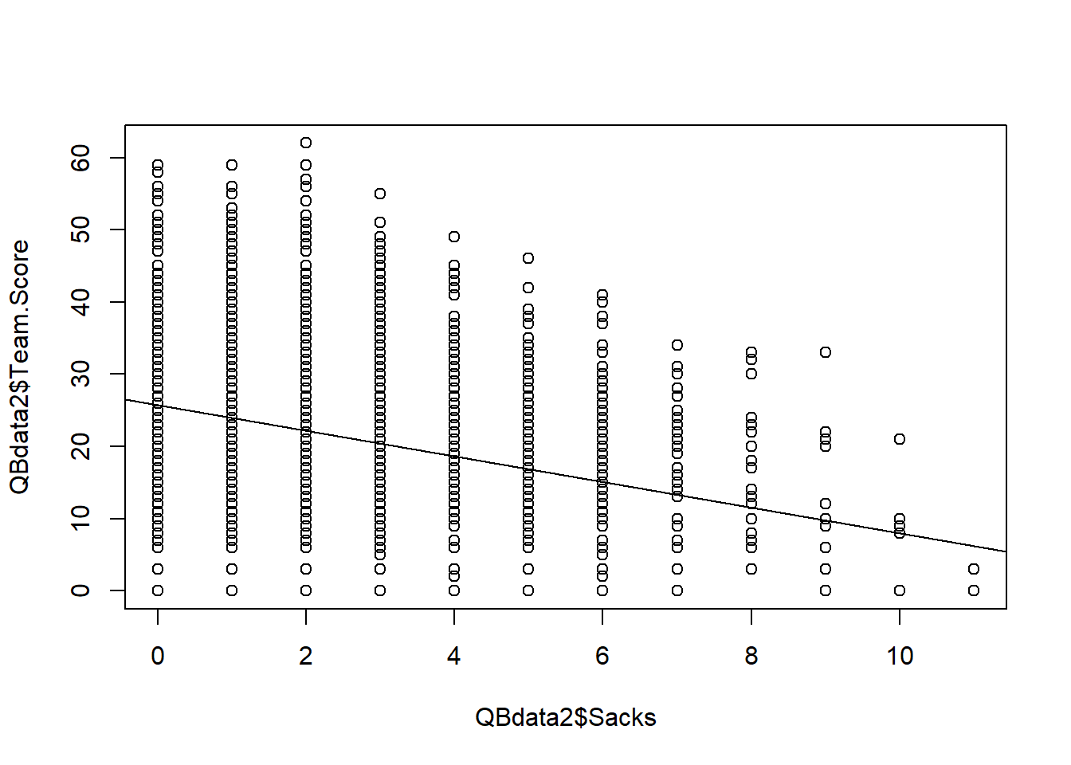
What is the relationship between sacks and points?
Correlation = -0.2919584
Regression line:
Team Score = -1.7713 * sacks + 25.71347

Slide 9
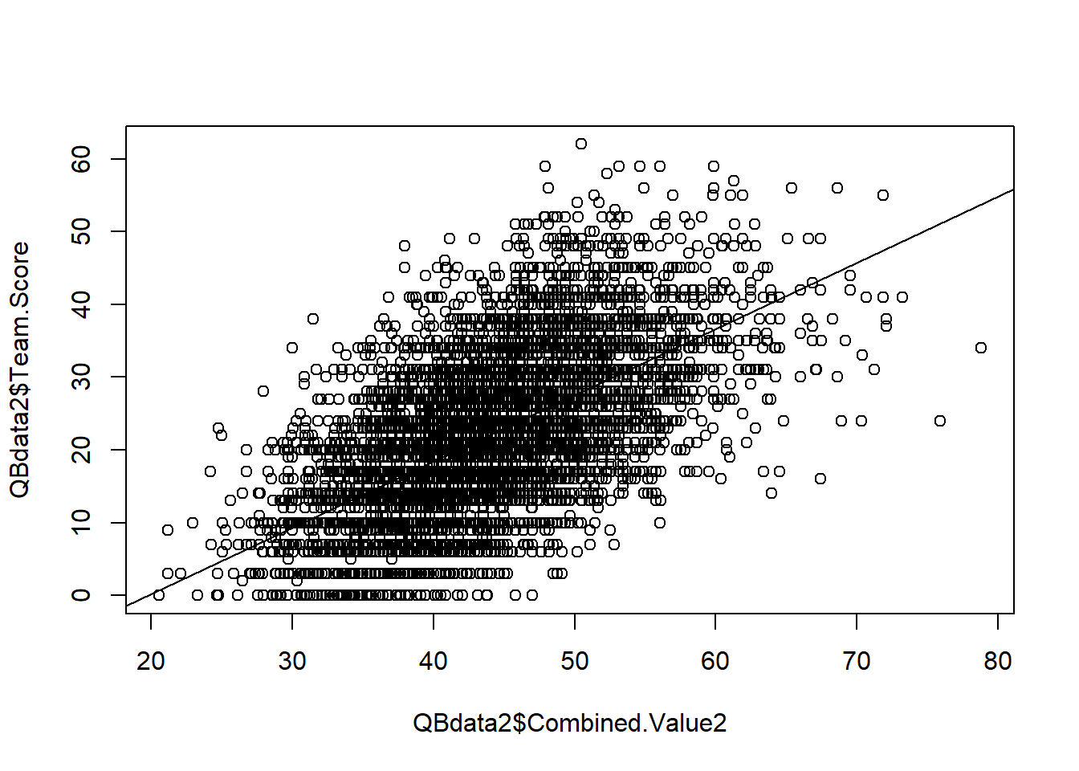
When both the YPA vs points and sacks vs points regressions are combined what is the relationship?
Correlation = 0.5975034
Combined Value2 = =26.91862 + ((2.91657 * YPA) - (1.7713 * Sacks))

Slide 10
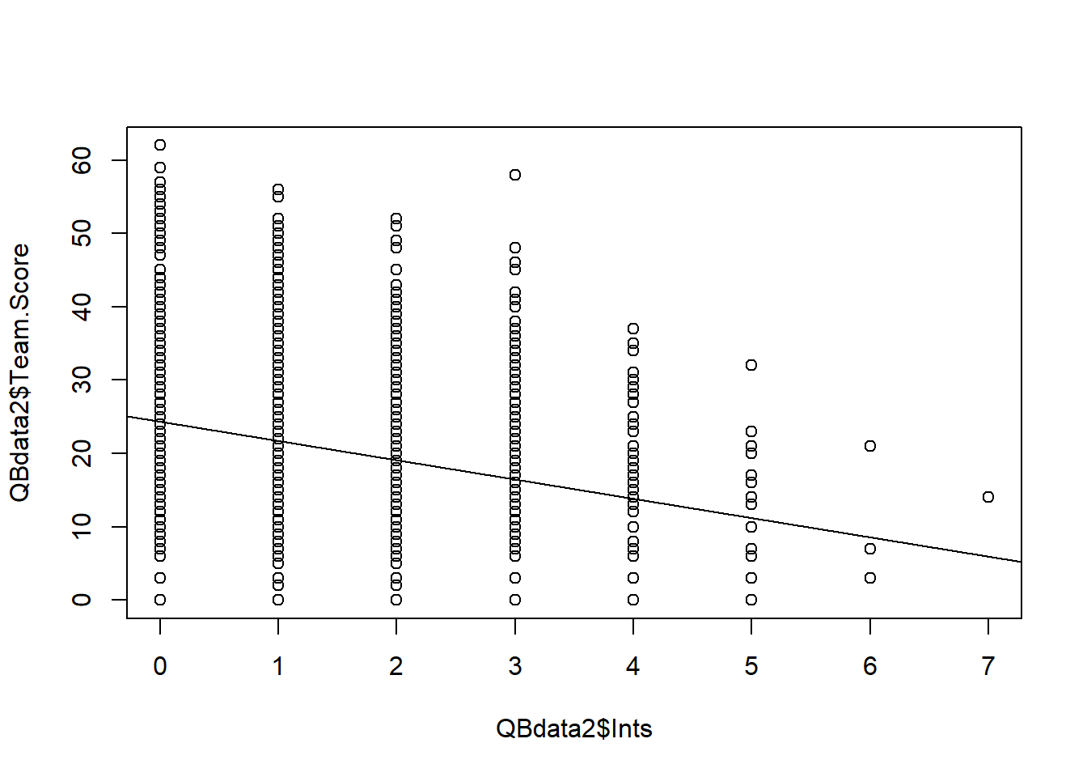
What is the relationship between interceptions and points?
Correlation = -0.2568585
Regression line Points = -2.6286 * Ints + 24.364
The correlation coefficient is weaker than the correlation coefficient for sacks (-0.2919584)

Slide 11
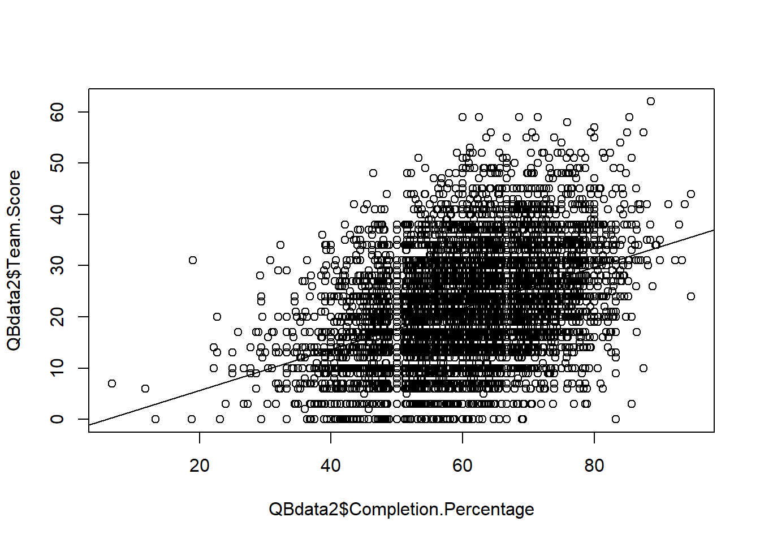
Is there a relationship between completion percentage and points?
Correlation = 0.4054223
regression line Points = .40067 * Completion Percentage - 2.375621
The correlation coefficient is weaker than the one for passing yards per attempt (0.5535805)

Slide 12
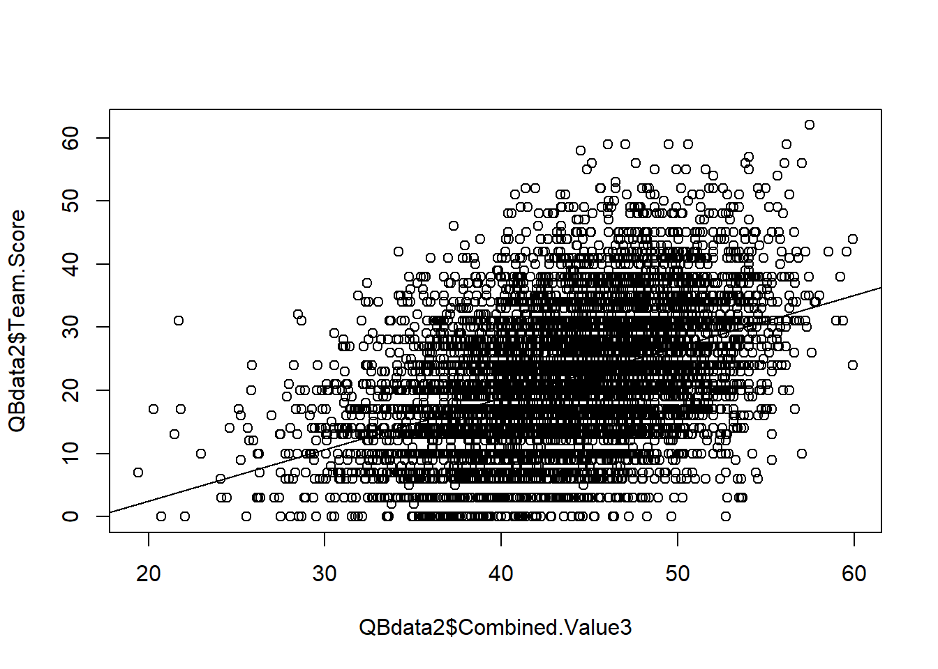
What is relationship between completion percentage paired with interceptions versus points scored?
Correlation = 0.4333426
Combined Value3 = (0.40067 * Completion Percentage) - (2.6286 * Ints) + 21.988379
The correlation coefficient is weaker than the one for the combination of sacks and ypa when compared to points

Slide 13

Was I Right?
Which correlates more strongly with points? Yards per pass attempt or completion percentage? Yards per pass attempt is more strongly correlated to points.
Which correlates more strongly with points? Sacks or Interceptions? Sacks are more strongly correlated to points (albeit in a negative way).
Which combination correlates more strongly with points? Sacks with yards per pass attempt or Interceptions with completion percentage? The combination of sacks and yards per pass attempts is more strongly correlated to points.

